Slide 1
Seasonal adjustment
ESTP-training
17-19/10/2023

Slide 2
0. Outline
ESS guidelines
Objectives
Methods
Series decomposition
Overview of seasonal adjustment methods
Final remarks

Slide 3
1. ESS Guidelines (2015)
Objectives
The objectives of seasonal adjustment are to identify and remove seasonal fluctuations and calendar effects which can mask short and long-term movements in a time series and impede a clear understanding of underlying phenomena. Seasonal adjustment is therefore a fundamental process in the interpretation of time series to inform policy making.
To avoid misleading results, seasonal adjustment should be applied only when seasonal and/or calendar effects can be properly explained, identified and estimated.
Seasonally adjusted series should have neither residual seasonality nor residual calendar effects and should show both the full trend-cycle and irregular component

Slide 4
1. ESS Guidelines (2015)
Methods
The use of regARIMA models is recommended to estimate and remove outliers before estimating the seasonal effect.
It is also recommended to use regARIMA modelling to calculate calendar adjustment factors. These calendar adjustment factors should take into account the different characteristics of national calendars.
The recommended seasonal adjustment methods are parametric methods based on signal extraction like Seats (Gomez and Maravall, 1996) and semi-parametric methods based on a set of predefined moving averages like Census II X 11 family (Findley et al., 1998) and X-13ARIMA-SEATS.

Slide 5
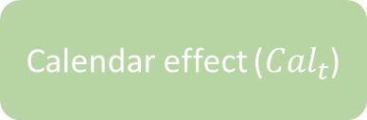
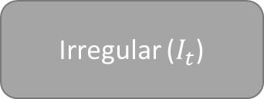

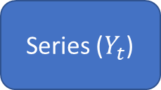

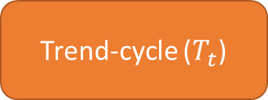
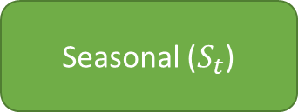
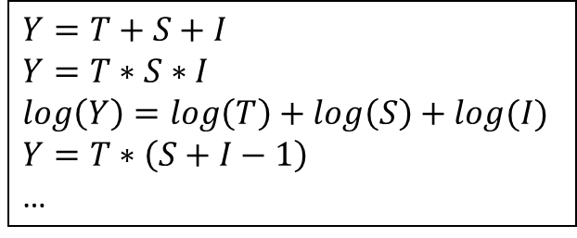
2. Series decomposition
Calendar effect (${Cal}_{t}$)
Seasonal ($S_{t}$)
Seasonally adj (${SA}_{t}$)
Series ($Y_{t}$)
$$Y=f(T, S,I)$$
Trend-cycle ($T_{t}$)
$$Y=T+S+I$$
$$Y=T∗S∗I$$
$$\log\left(Y\right)=\log\left(T\right)+\log\left(S\right)+log(I)$$
$$Y=T∗\left(S+I−1\right)$$
…
Irregular ($I_{t}$)

Slide 6
2. Decomposition
Trend-cycle
Smooth (?)
Around the series
Seasonal
Periodic, with slow changes (?)
Nearly 0 or 1 in average during 1 cycle (year)
Irregular
Residual
Around 0 or 1
No actual definition of the components ⇒ Methods/software give different results
⇒ Seasonally adjusted not necessary smooth

Slide 7
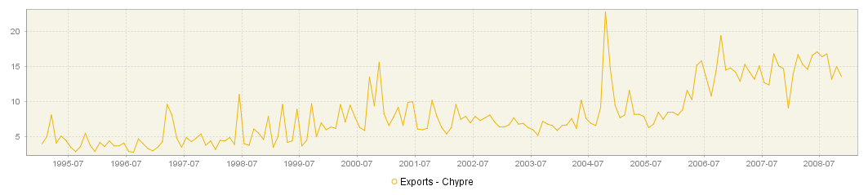
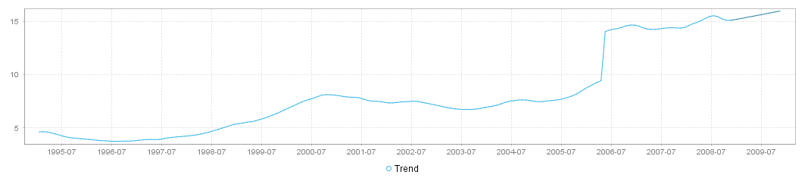
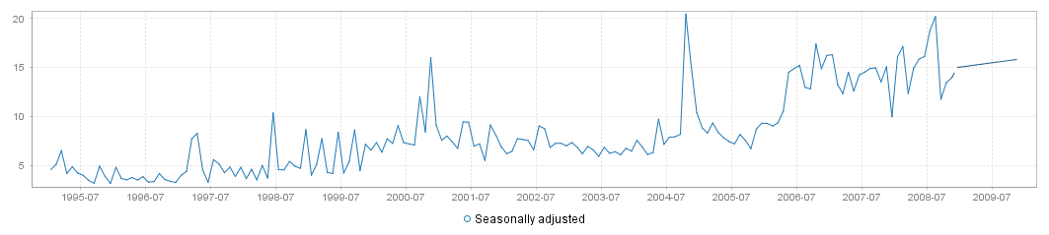
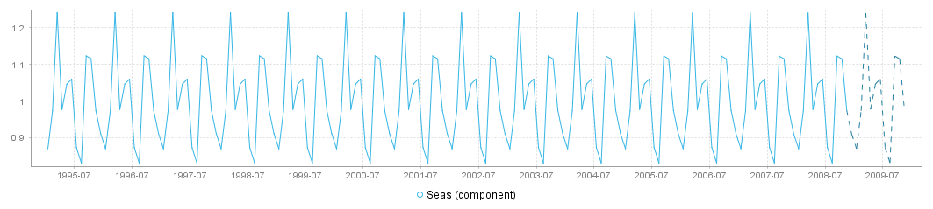
Volatile series
Stable trend and seasonal components
Volatile seasonally adjusted series

Slide 8
3. Rapid overview of the main SA methods
Non parametric
Parametric
Machine learning
Lo(w)ess
Moving averages
Stochastic
Deterministic
RegArima
models
Structural models
Prophet
STL
X11
Canonical decomposition
Stamp,
RegCmp,
(T)Bats,
…
X12-ARIMA
Kalman filter
WK filter
Tramo-Seats

Slide 9
3. Rapid overview of the main SA methods
Non parametric
Parametric
Machine learning
Lo(w)ess
Moving averages
Stochastic
Deterministic
JD+ 2.x
RegArima
models
Structural models
Prophet
STL
X11
Canonical decomposition
X12-ARIMA
Kalman filter
WK filter

Slide 10
3. Rapid overview of the main SA methods
Non parametric
Parametric
Machine learning
Lo(w)ess
Moving averages
Stochastic
Deterministic
JD+ 3.0
RegArima
models
Structural models
Prophet
STL
X11
Canonical decomposition
X12-ARIMA
Kalman filter
WK filter

Slide 11
4. Final remarks
Need to understand the principles of the main algorithms (not all the technical details)
Software automates many details
Need for good quality reports
Recall: “seasonally adjusted series should have neither residual seasonality nor residual calendar effects”
Need to “industrialize” the seasonal adjustment processing
Additional request: “Seasonal adjustment procedures should generate consistent and robust results”

